Slide 1


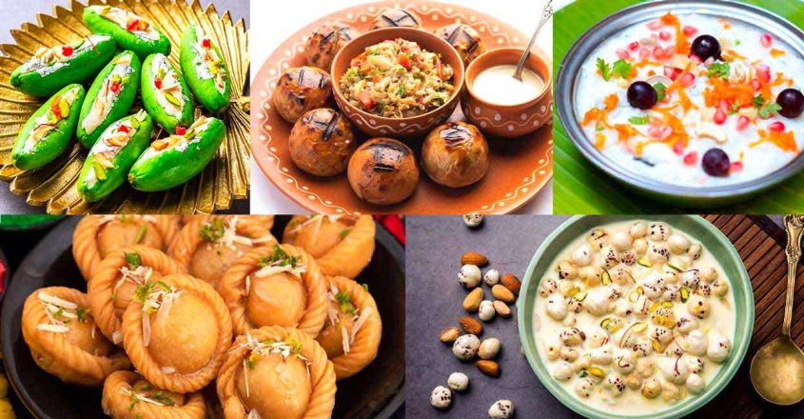
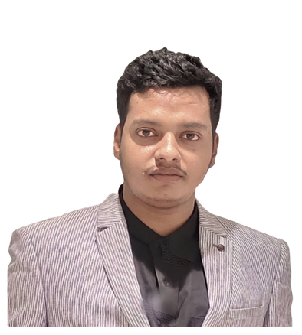

PRODUCT
PITCH
Team- IIITL MBA
Priya Ranjan Kumar
Hrishabh Shukla
1

Slide 2




BRAND PERSONA
Name- BioDishar( Comprising a traditional welling while promoting the environment)
Theme-
Rooted in Tradition, Powered by Nature
Tag Line-
“Authentic Nutrition, Made Simple”
Mission-
To deliver wholesome, organic-based pre-mixed foods that reconnect people with the healthy, traditional meals our ancestors once ate. We aim to nourish the body with simple, authentic ingredients that promote long-lasting health and well-being
Vision-
To inspire a global movement towards healthier living by offering organic, easy-to-make foods that embrace the wisdom of our ancestors, fostering well-being through simplicity and authenticity and open to connect worldwide
2

Slide 3
STP Framework
Segmentation
Demographic: Age (above 5), income (lower middle- upper), lifestyle (health-conscious individuals, families), education (educated, with awareness of organic food benefits)
Geographic: Urban and semi-urban areas with access to organic products or wellness-conscious populations.
Psychographic: Health-conscious individuals, eco-conscious consumers, wellness enthusiasts, parents looking for nutritious food options for their children, Grounded people to traditions.
Behavioral: People who are already consuming organic or homemade food, people seeking convenience without compromising health and people who want to experience every state traditional organic and eco-friendly foods.
Targeting
Health-conscious individuals (aged 25-45) who prioritize organic, home-cooked meals for better well-being, who seats way apart from home and want to try traditional healthy foods.
Young families and parents looking for convenient yet healthy food alternatives for themselves and their children.
Fitness enthusiasts and people following a wellness lifestyle, interested in nutritious and natural food options.
Specially immigrated persons who seeking healthier alternatives to processed food and interested in preserving traditional, healthy eating habits
3

Slide 4
STP Framework
Positioning
A bridge to traditional nutrition: "Bringing back the healthy, homemade food our ancestors cherished."
Convenient & wholesome: "Pre-mixed organic food that's quick, healthy, and packed with authentic flavors."
Premium, healthy choice: A premium product with natural, organic ingredients that ensure a healthier lifestyle.
Eco-friendly & sustainable: A brand that cares for both health and the planet.
4 Ps’
Product
Price
Place
Promotion
A pre-mix based food like- Sattu mix( Combination of sattu+mustard oil+salt+Ajwain+Kalaunji+Homemade mango pickle spices) and Spicy ghee based mix(Combination of Organic desi ghee+ Black pepper+ Black salt)
Low to mid range
For Sattu mix- Rs80 in India and in foregin 120 excluded trade charges
Discount on Combo and multi-packet purchase
Retails and wholesale
Online( Flipkart, Amazon, Walmart, etc.)
Digital Marketing
Retails Promotions
4

Slide 5
GTM Plan
Market Analysis
Competitor Analysis
Target Market-
Primary- Health-conscious millennials and Gen Z, urban dwellers, and busy professionals.
Secondary: Families looking for quick, healthy meal solutions.
Knorr-Pre-mix and Ready to cook
Beyond Meat (ready-to-cook products).
Blue Apron (meal kits).
Maggi (seasoning and quick meals).
Differentiation-
First and foremost NO-SUCH KIND OF PRE-MIX IS AVAILABLE IN WORLD RIGHT NOW.
BioDishar heritage in delivering flavorful add on meals globally.
Sustainability focus with eco-friendly packaging.
Affordable pricing compared to premium competitors.
Market Size-
Growing global plant-based food market, estimated to reach $35 billion by 2027.
Opportunity to dominate the mid lower to High priced segment by giving traditional touch.
Trends-
Increasing demand for plant-based and sustainable products along with no such brand is digging that well & Preference for convenience without compromising on taste.
Customer Persona
Persona 1- Ranjan, 32, urban professional, who is from Bihar, lives in Switzerland and looking for that perfect combination of spices with Sattu that he loves but has limited time and experience.
Persona 2- The 23 year old person feels bored while eating hostel foods.
Packaging
Bright, vibrant, eco-friendly packaging highlighting sustainability and flavor profiles
Value proposition
BioDishar pre-mix-"Convenient, sustainable, and bursting with bold and traditional flavors, BioDishar meal kits make healthy eating effortless."
Core Benefits-
Quick preparation (under 2 minutes).
Rooted flavors from the soil of farmers.
80% Plant-based ingredients and 20% organic based ingredients, sourced sustainably.
Affordable price point.
Marketing and Sales Strategy
Marketing Channels-
Digital- Social media platforms (Instagram, TikTok, Facebook) with influencer partnerships.
Retail- Promotions at major grocery chains and e-commerce platforms.
5

Slide 6


Content Marketing- Recipes and cooking demos featuring Knorr kits on YouTube and food blogs.
Operational Paln
Key Messages-
“In the wind of new trend don’t forget the old one"
"BioDishar- Your on the go add on pre-mix meal”
Launch Phases
Phase 1: Pilot launch in select urban markets like in Bihar and UP with high plant- Organic based demand and to roll out in summer season as our current product is more beneficial in summers.
Phase 2: National rollout after 4 months as the market captures it, current market for pre-mix is hitting stone with no success mainly due to the bad feedback loop but here there is no such things can be happen due to absence of any process involves while packaging.
Phase 3: Expansion to international markets (Europe and all over Asia) by promoting as a ancestral based food, although we know that over the world there is no such place where Indian people won’t live specially Bihari’s/Up.
Resources-
Partnerships with local farms for sourcing.
Investment in production automation for scaling.
Collaboration with eco-friendly packaging suppliers.
Distribution and Delivery
Retail Channels-
Large grocery chains (e.g., Walmart, Kroger, Tesco, Flipkart, Amazon, etc. ).
Specialty health food stores.
Online Platforms-
BioDishar official website and E-commerce platforms (Amazon, Instacart).
6

